Slide 1
Backtracking Algorithm

Slide 2
Introduction
Backtracking is an algorithmic-technique for solving problems recursively by trying to build a solution incrementally, one piece at a time, removing those solutions that fail to satisfy the constraints of the problem at any point of time (by time, here, is referred to the time elapsed till reaching any level of the search tree).
There are three types of problems in backtracking –
Decision Problem – In this, we search for a feasible solution.
Optimization Problem – In this, we search for the best solution.
Enumeration Problem – In this, we find all feasible solutions.

Slide 3
Problem 1 : Subset Sum
Problem Statement:
Subset sum problem is to find subset of elements that are selected from a given set whose sum adds up to a given number K. We are considering the set contains non-negative values. It is assumed that the input set is unique (no duplicates are presented).

Slide 4
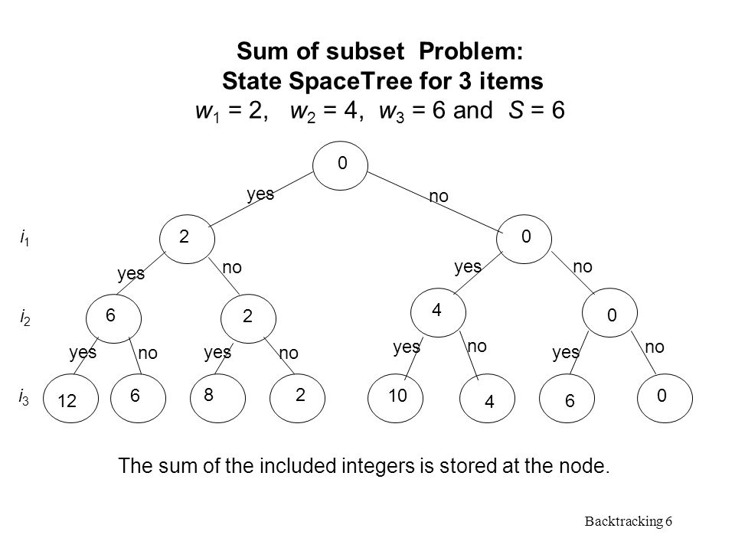
Subset Sum: Backtracking Approach
Using exhaustive search we consider all subsets irrespective of whether they satisfy given constraints or not. Backtracking can be used to make a systematic consideration of the elements to be selected.
Assume given set of 3 elements, say {2,4,6} and we need to get sum S = 6. Tree diagrams can be used to design backtracking algorithms. The following tree diagram depicts approach of generating variable sized array

Slide 5
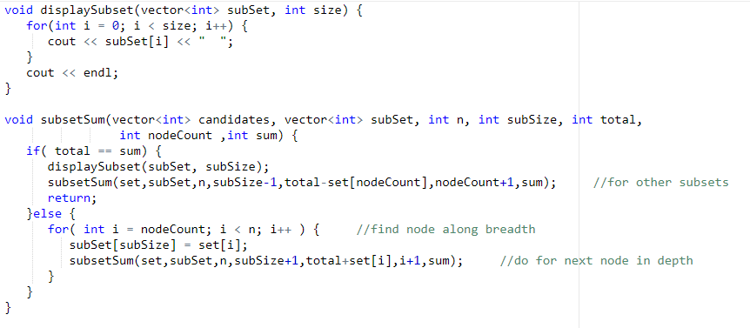
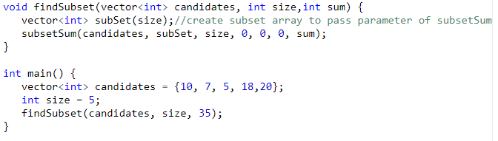
Subset Sum : Implementation
Candidates = {10, 7,5,18,20}
Target = 35
Solutions: {10 7 18}, {10 5 20}

Slide 6
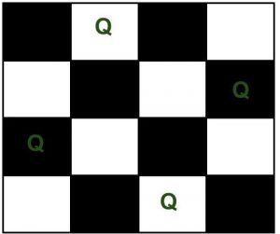
N Queens :
The N Queen is the problem of placing N chess queens on an N×N chessboard so that no two queens attack each other. We’ll be considering 4 queens problem in this example.
Solution:
{ 0, 1, 0, 0}
{ 0, 0, 0, 1}
{ 1, 0, 0, 0}
{ 0, 0, 1, 0}

Slide 7
N Queens : Backtracking Approach
The idea is to place queens one by one in different columns, starting from the leftmost column.
When we place a queen in a column, we check for clashes with already placed queens.
In the current column, if we find a row for which there is no clash, we mark this row and column as part of the solution.
If we do not find such a row due to clashes then we backtrack and return false.

Slide 8
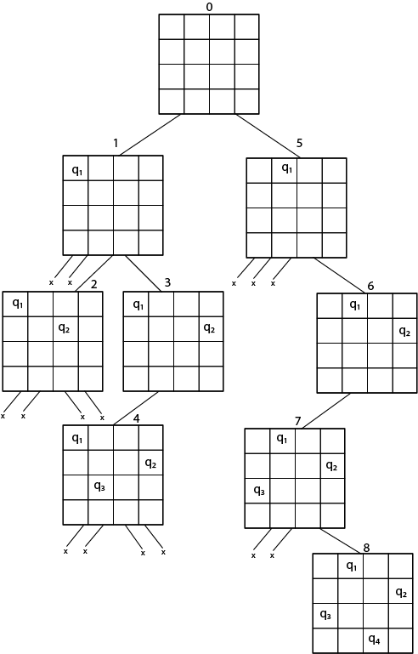
N Queens: Approach
1) Start in the leftmost column
2) If all queens are placed
return true
3) Try all rows in the current column. Do following for every tried row.
a) If the queen can be placed safely in this row then mark this [row,
column] as part of the solution and recursively check if placing
queen here leads to a solution.
b) If placing the queen in [row, column] leads to a solution then return
true.
c) If placing queen doesn't lead to a solution then unmark this [row,
column] (Backtrack) and go to step (a) to try other rows.
3) If all rows have been tried and nothing worked, return false to trigger
backtracking.

Slide 9
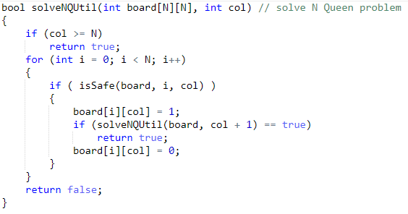
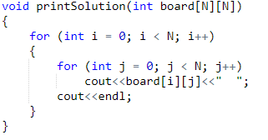
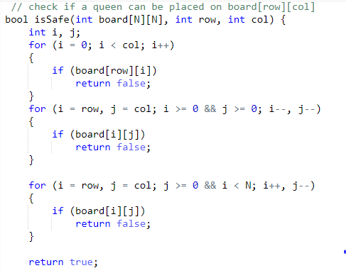
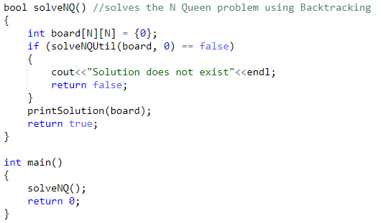
Implementation

Slide 10
Assignment:
https://www.geeksforgeeks.org/the-knights-tour-problem-backtracking-1/
https://www.geeksforgeeks.org/rat-in-a-maze-backtracking-2/
https://leetcode.com/problems/permutations/
https://leetcode.com/problems/combination-sum/

